Slide 1


Extracting Online Data Through APIs in Python

Slide 2
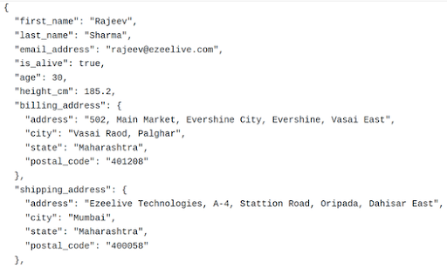
API Format
Json data
Submitting requests. Restaurant Example
How to extract

Slide 3
Requesting Access
Some APIS are free with no key(MovieDB)
Most APIS require you to request access. But are free and quick request(spotify, redditt)
Some APIS take a long time to receive approval before use(Instagram, X)
Some APIS cost money(SEC filings edgar)

Slide 4
Github page for workshop
https://github.com/jgrips9/SP24-APIS
Contains following:
How to request access to APIS(Spotify, Reddit, Google search API)
Sample code for each above(jupyter, python, Google Colab)
Copy of slides

Slide 5
Coding Example: MovieDB
tutorial
Sample code

Slide 6
Coding Example: Spotify
Instructions to request access
Sample code

Slide 7
Coding Example: Reddit
Instructions to request access
Sample code

Slide 8
Coding Example: Google Search API
Instructions to request access
Sample code

Slide 9
CCSS Resources
Workshops
Consultations
Free software through cloud computing

Slide 10
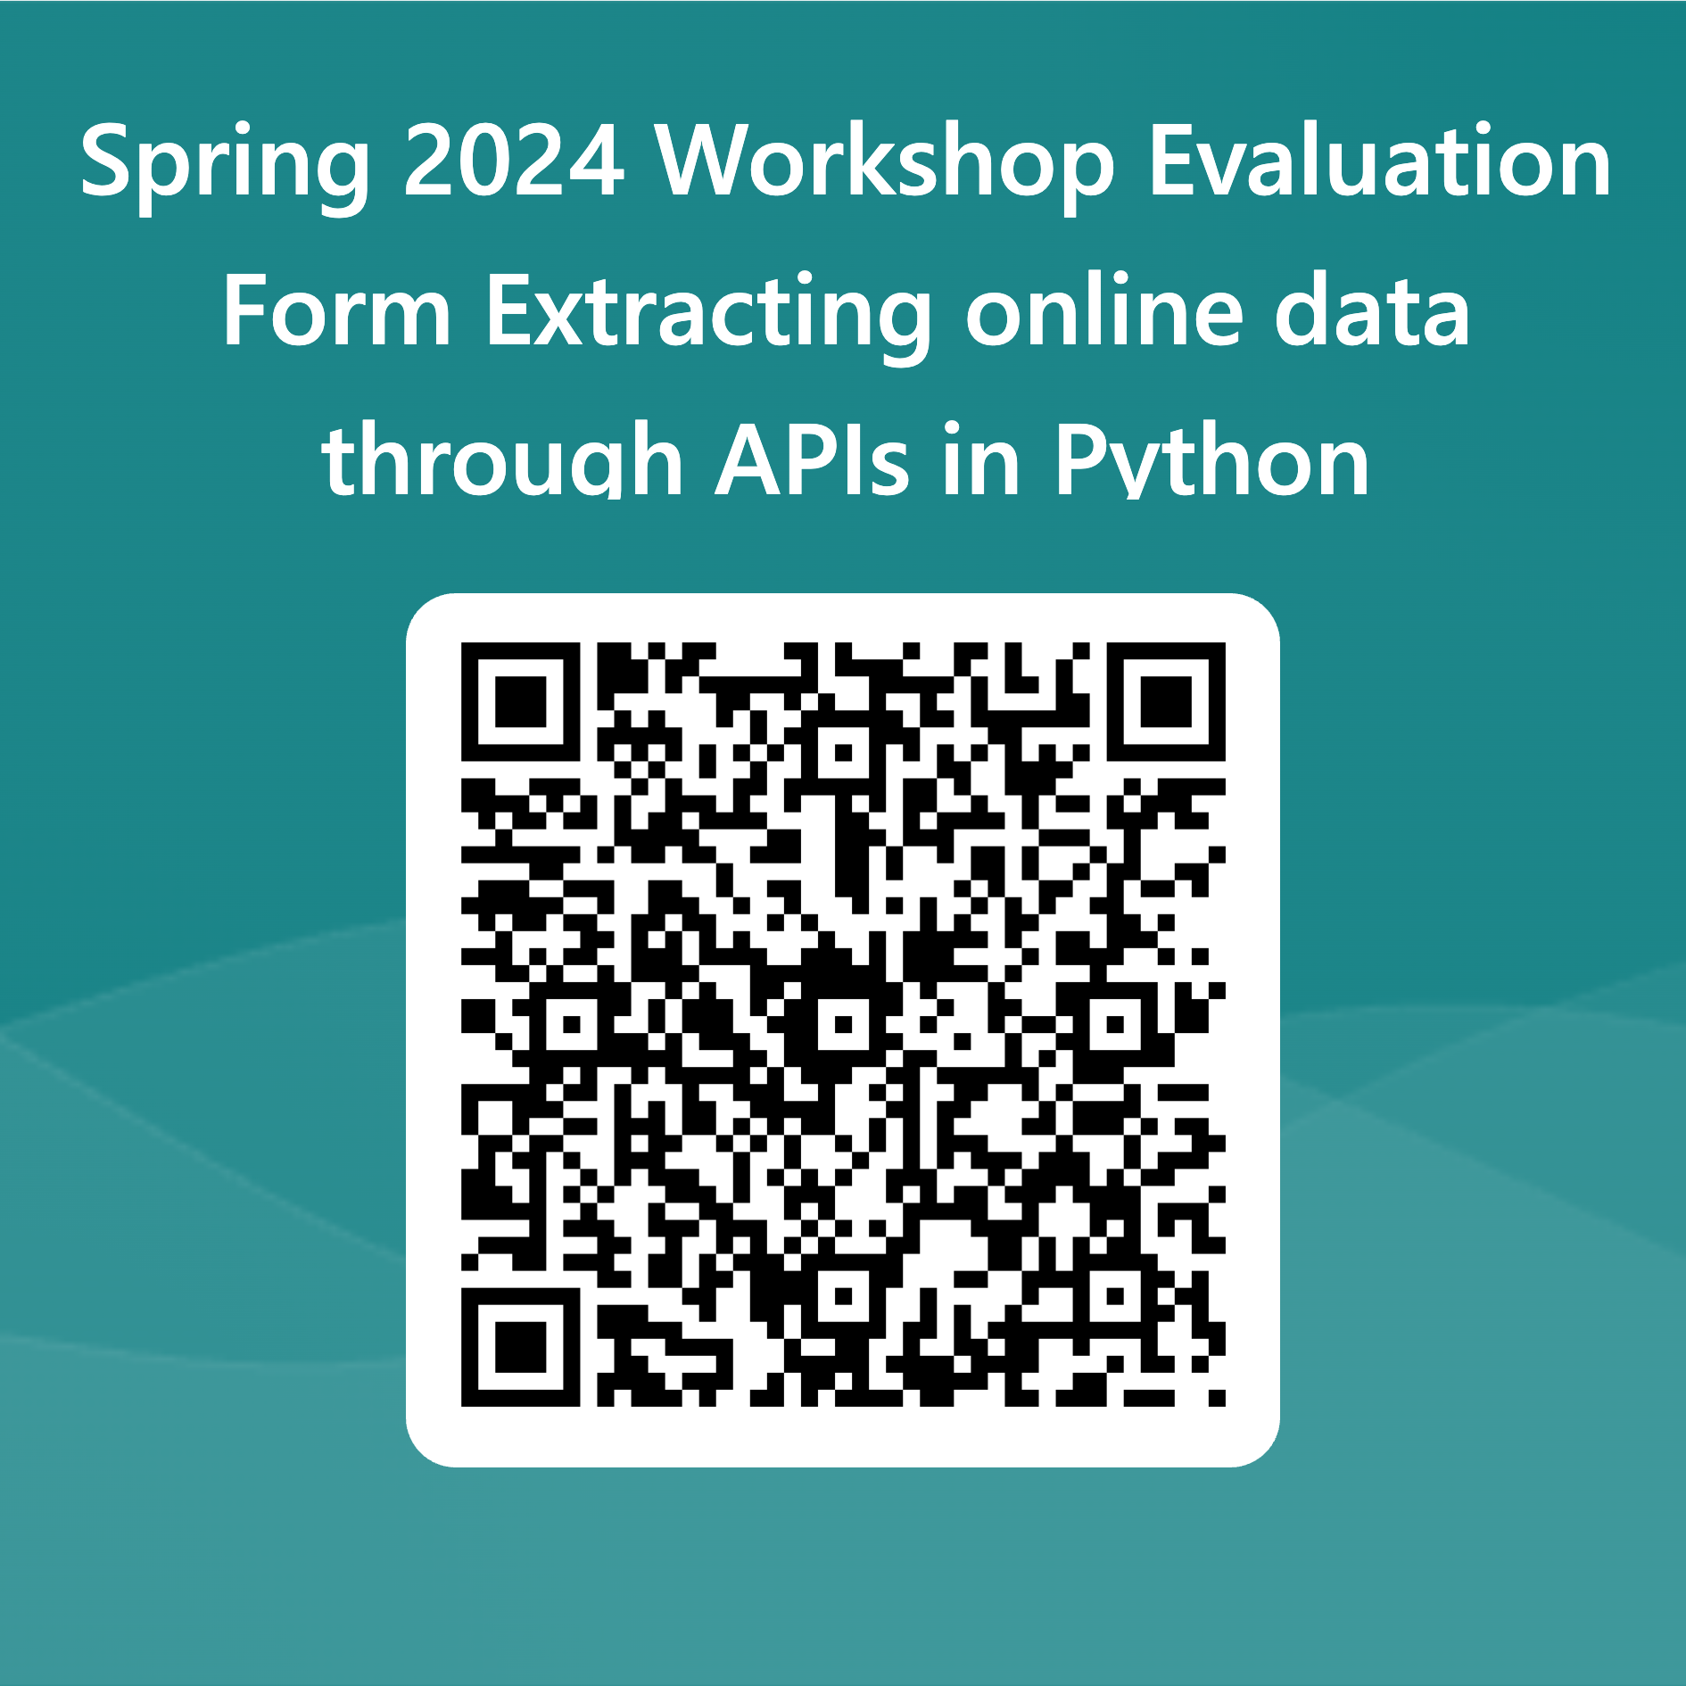
Evaluation

Slide 11
Thank you!
Contact us at socialsciences@cornell.edu

